Slide 1
ANALYSIS OF RPL ATTACKS
USING COOJA SIMULATOR
Bavya Balakrishnan
192IT003

Slide 2
INTRODUCTION
RPL is a routing protocol designed for low power and lossy networks
Devices constrained in memory, energy and processing power.
They have low data rate and experience relatively significant packet losses
Due to the open environment of operation more susceptible to several security attacks
Analysing the various attacks on RPL protocol using simulation in contiki platform.
Main objective is to test and show the effect of some chosen attacks

Slide 3
MOTIVATION
Constrained devices employed to monitor, measure and report data.
To meet the specific requirements new protocols coming into picture
IEEE 802.15.4, 6LowPAN
Security side of RPL.
We analyse various attacks such as Packet dropping attack, Flooding, Version number modification and Decreased rank

Slide 4
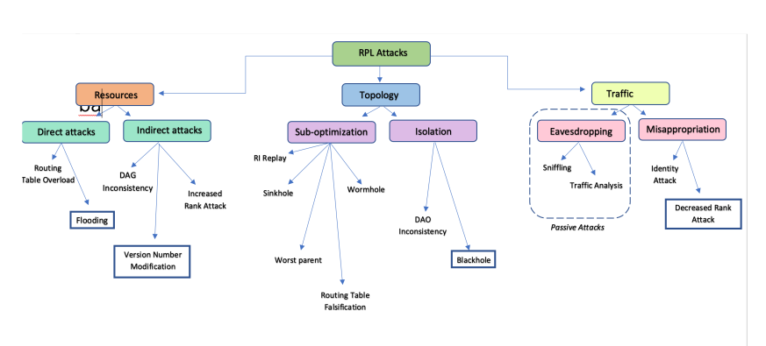
PROBLEM STATEMENT
Security techniques from other networks cannot be applied straight away because of the specific constraints of RPL. Chose some sample attacks from different categories to test on RPL . The attacks in blue frames are the ones we chose to explore.
Taxonomy

Slide 5
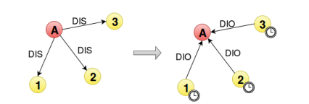
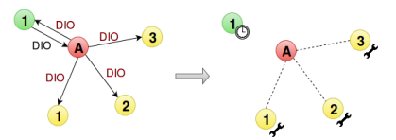
Chose some sample attacks from different categories to test on RPL .
Flooding:
Version Number Modification:

Slide 6
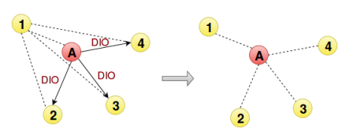
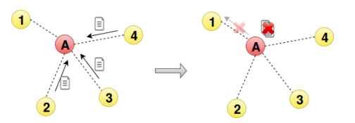
Decreased Rank attack
Blackhole attack

Slide 7
Methodology
Flooding
#define RPL_DIS_INTERVAL 0
#define RPL_DIS_START_DELAY 0
Also in rpl-timers.c replace "next_dis++;" with "next_dis++; int i=0; while (i<10) {i++; dis_output(NULL);
Version number Modification
In rpl-icmp6.c replace dag->version with dag->version++ in dio_output
Decreased Rank
RPL_CONF_MIN_HOPRANKINC is set to 0 in udp_sender.c of attacker node.
RPL_MAX_RANKINC in rpl-private.h to limit the number of levels of children in the network. i.e. leaf nodes will not forward any DIOs.
INFINITE_RANK is reduced to 256 from 0xffff.
Blackhole
selective forwarding by dropping DAO messages.
Below lines in rpl-icmp6.c are commented
.uip_icmp6_send(rpl_get_parent_ipaddr(dag->preferred_parent),ICMP6_RPL,RPL_CODE_DAO, buffer_length);
goto fwd_dao

Slide 8
EXPERIMENTAL SETUP
Experiments are conducted on Cooja 3.0
Radio Medium: Unit Disk Graph Medium(UDGM): Distance loss
Mote startup delay: 1000 ms
Random seed: 123456
Total number of nodes 10 out of which one is malicious node and one is root.

Slide 9
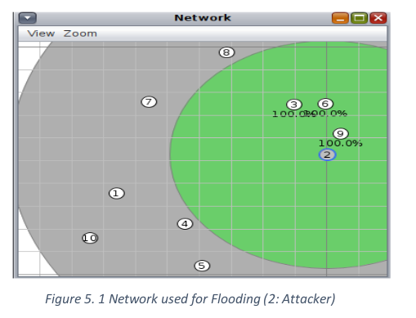
RESULTS
Flooding
The malicious node immediately starts sending DIS messages to its neighbours, then triggering DIO messages and trickle timers reset.
No change in DAG.
Important energy exhaustion is observed.
Particularly impacted by the attack in terms of ON and RX times due to multicast DIS.
Around 1% of total packets were DIS messages generated from malicious node 2 to disturb the network and every other node generated 0.1% DIS messages.

Slide 10
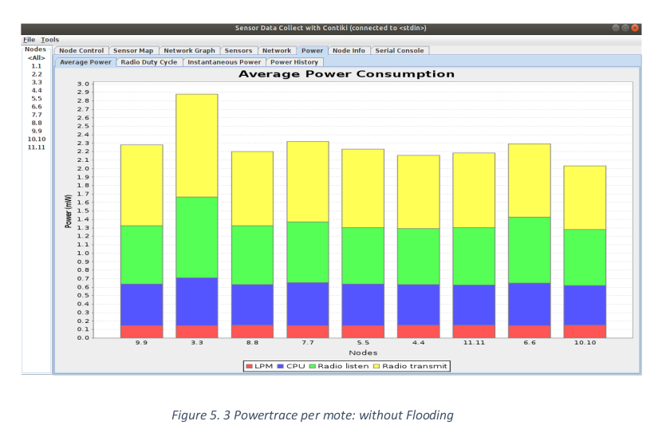
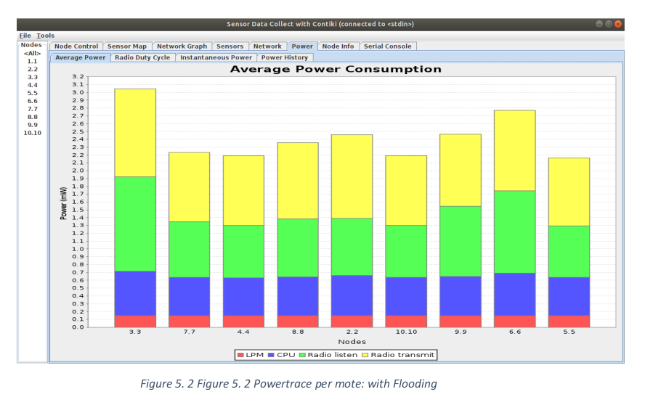
Flooding power trace

Slide 11
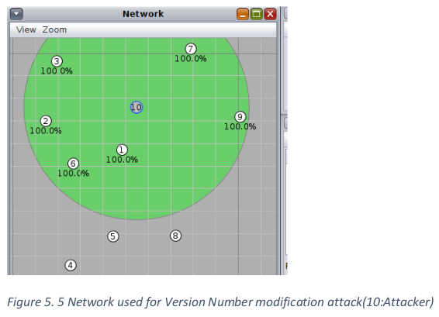
Version Number modification
Since root handles this there is no change in DAG.
But important energy exhaustion is observed.
Significant power increase in all nodes (above 1.50mW). Attacker and its neighbours have power above 4mW.

Slide 12
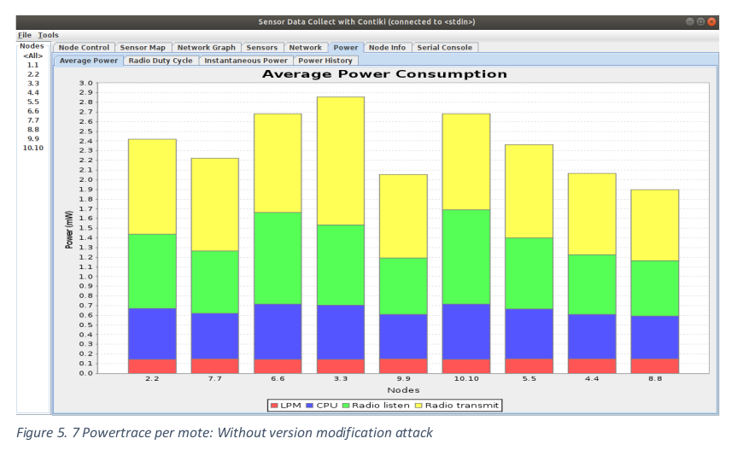
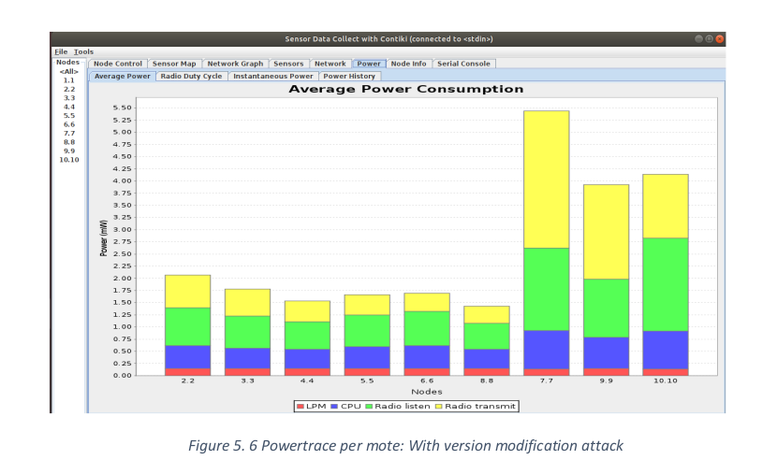
Power trace Version modification

Slide 13
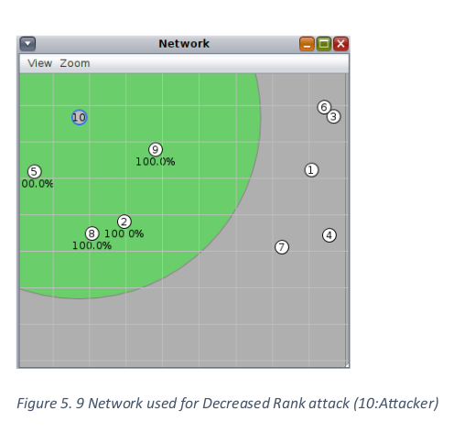
Decreased Rank
The malicious node will advertise a better rank than neighbours, causing the DAG to be modified.
Took a lot of time to start data transmission(network stabilization took time).
High power consumption by attacker node and its neighbours.
Initially only the unaffected nodes send packets.

Slide 14
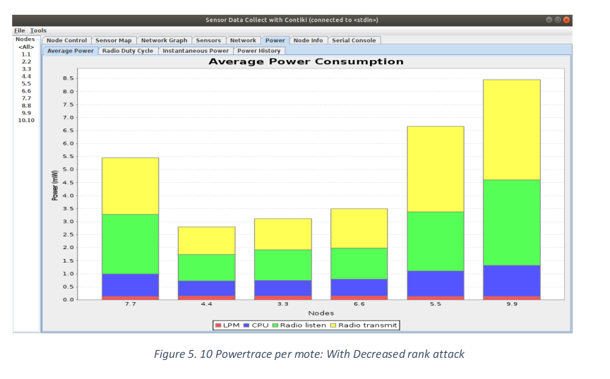
Decreased rank Power trace

Slide 15
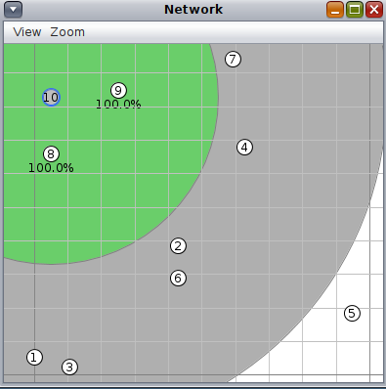
Blackhole attack

Slide 16
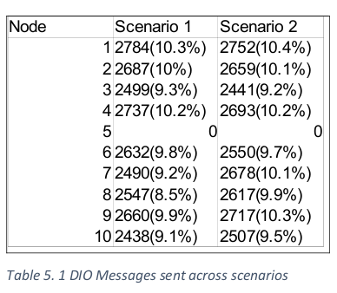
Blackhole
The increase in number of DIO message exchanged indicates the unstable topology with respect to routing of packets.
Time duration: 500000ms
Scenario 1: Without blackhole attack
Total no packets: 26933
Total no DIO packets: 23726(88.1%)
Scenario 2: With blackhole attack
Total no packets: 26391
Total no DIO packets: 23830(90.3%)
We can observe an increase in DIO packets for nodes 1,2,7,8,9,10 . Where 8,9 are the neighbours of malicious node 10.

Slide 17
CONCLUSION
Impact of various attacks uniformly chosen amongst the presented taxonomy on RPL is analysed using Cooja simulator.
Found that such attacks affected the resources, topology and integrity of the WSN network.
Possible further improvements includes, testing the network with multiple malicious nodes, explore the mitigation strategies for each attack.

Slide 18
REFERENCE
Impact of Packet Dropping Attacks on RPL, Arvind Kumar ,Rakesh Matam , Shailendra Shukla
T. Winter et. al, RPL: IPv6 Routing protocol for Low power and Lossy Networks, Internet Draft draft-ietf-roll-rpl-17 Retrieved, June 2015.
Geoff Mulligan, The 6LoWPAN architecture, EmNets 2007: Proceedings of the 4th workshop on Embedded networked sensors, ACM, 2007.
IEEE Standard. 802.15.4, Wireless LAN Medium Access Control (MAC) and Physical Layer (PHY) Specification for Low Rate Wireless Personal Area Networks (LR-WPANs),
IEEE 2011.Mobile and Embedded Computing: RPL Attacks Framework, Alexandre D’Hondt

